Slide 1

Introduction to Bioconductor (2)
Antonio Mora
Bioinformatics Lab Workshop, 21/06/2019

Slide 2

Summary
Summary of the previous workshop
Basic packages for annotation and communication (AnnotationDbi / OrgDb, AnnotationHub, rtracklayer, and others)
Working with visualization (Gviz)

Slide 3
1. Summary of the previous workshop

Slide 4
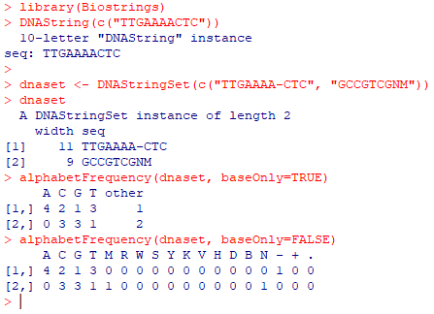
Biostrings
Biostrings contains tools for working with sequences (strings).
The main classes are DNAString, RNAString and AAString. Also, classes for lists such as DNAStringSet and so on.
Many methods for manipulating biological sequences (ex: alphabetFrequency, etc).

Slide 5
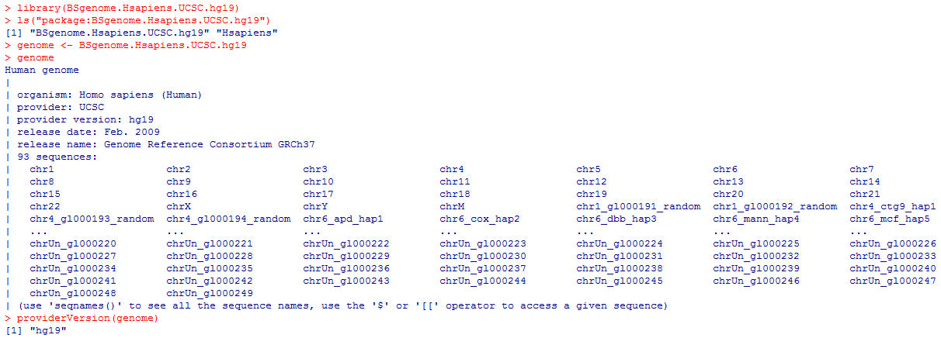
BSgenome
BSgenome is a collection of packages (BS.Hsapiens.UCSC.hg38, BS.Dmelanogaster.UCSC.dm3, and so on), which contain whole-genome sequences.

Slide 6
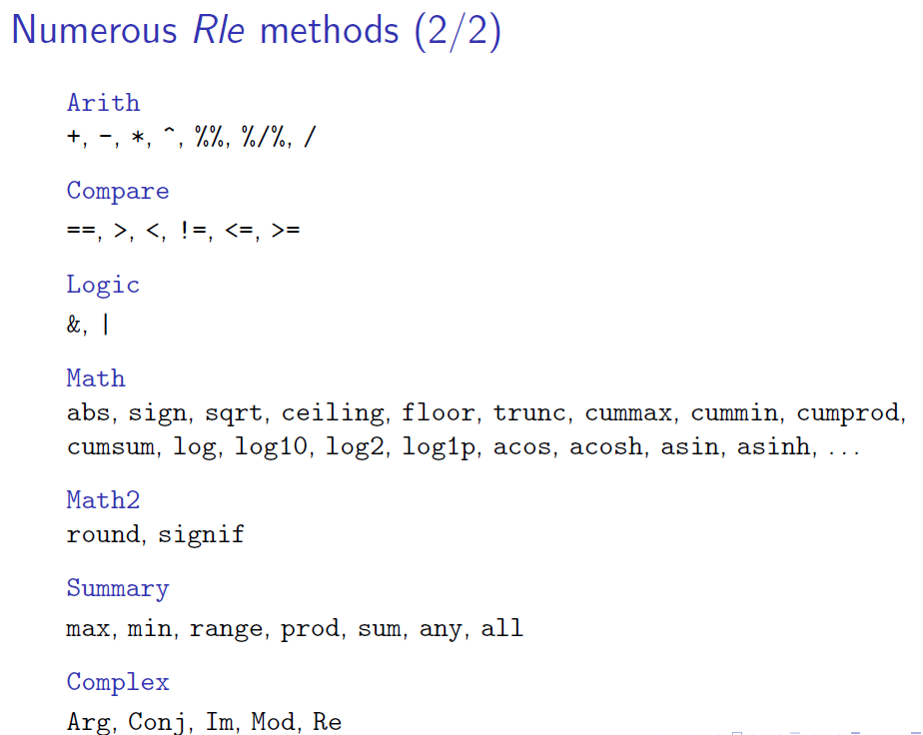
IRanges
IRanges is the basic package to store range data.
It uses Run-Length Encoding (RLE), which is a compression technique to store long and repetitive sequences. Instead of storing the full sequence, an RLE couples values with run lengths: c(1,1,2,2,2) would be two 1s and three 2s.

Slide 7
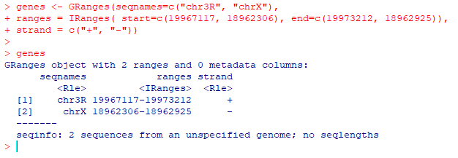
GenomicRanges
Also, classes for lists of GRanges (GRangesList).

Slide 8
2. Basic packages for Annotation and Communication

Slide 9
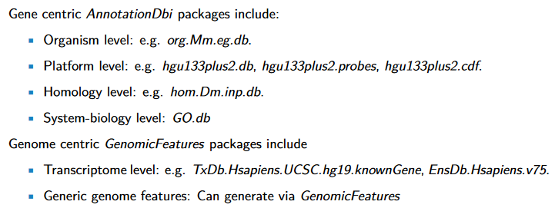
AnnotationDbi
Annotation packages in Bioconductor are based on “AnnotationDbi” (AnnotationDb objects).
In order to create new annotation packages, one should follow the documentation of the “AnnotationForge” package.
OrgDb objects, ChipDb objects, TxDb objects, Go.db objects, etc.
Updated every six months.
Source: CARLSON, M. (2019), AnnotationDbi: Introduction to Bioconductor Annotation Packages

Slide 10
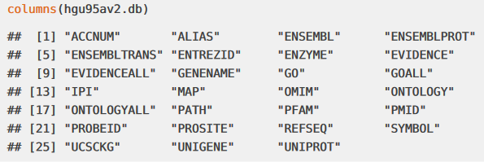
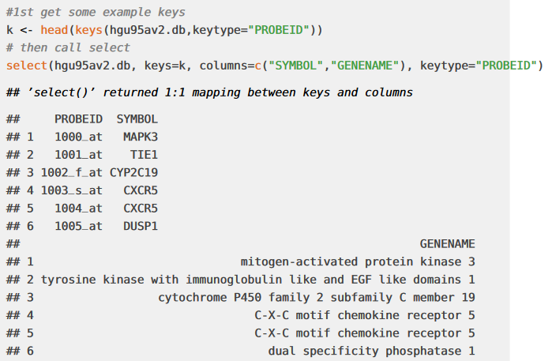
AnnotationDbi
Main methods to access AnnotationDb (and OrgDb and GO.db objects) are: “columns”, “keytypes”, “keys”, and “select”.
Source: CARLSON, M. (2019), AnnotationDbi: Introduction to Bioconductor Annotation Packages

Slide 11
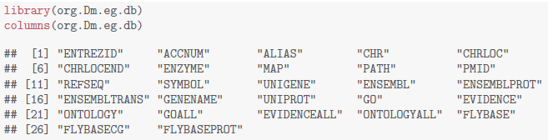
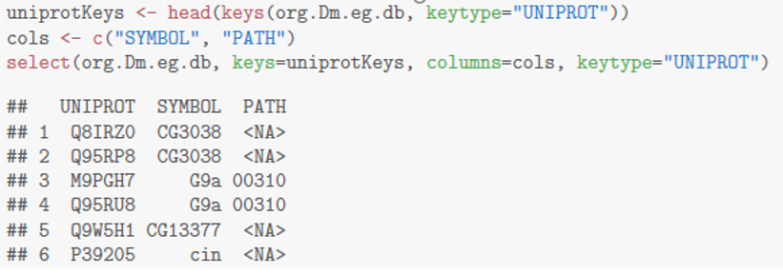
AnnotationDbi
An example with an org.db database:

Slide 12
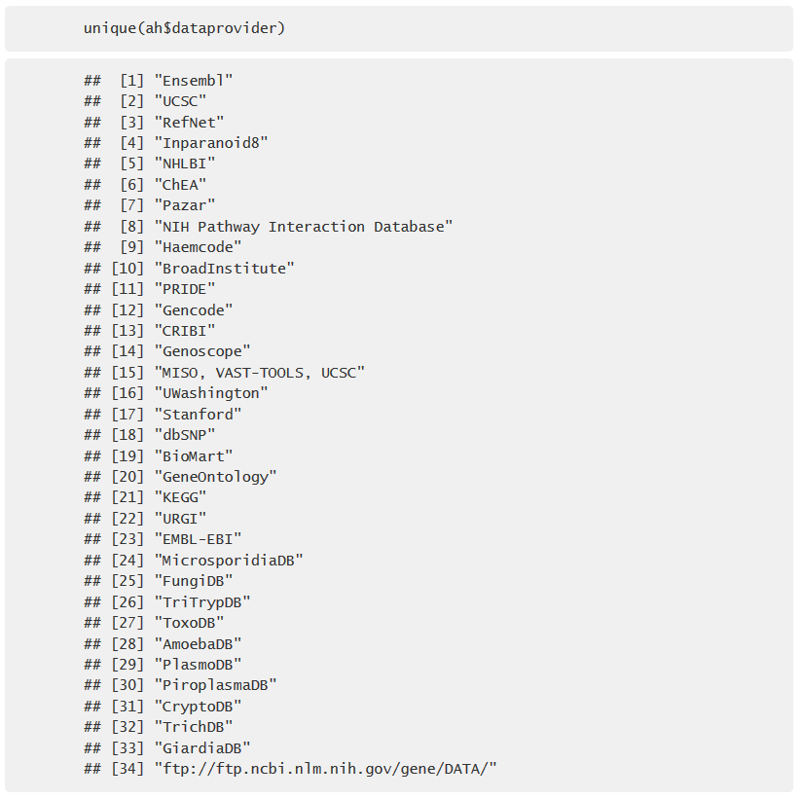
AnnotationHub
While AnnotationDbi consists of database packages, AnnotationHub is a server to provide R access to several databases.
AnnotationHubData is the package to create AnnotationHub objects.
Source: Package documentation

Slide 13
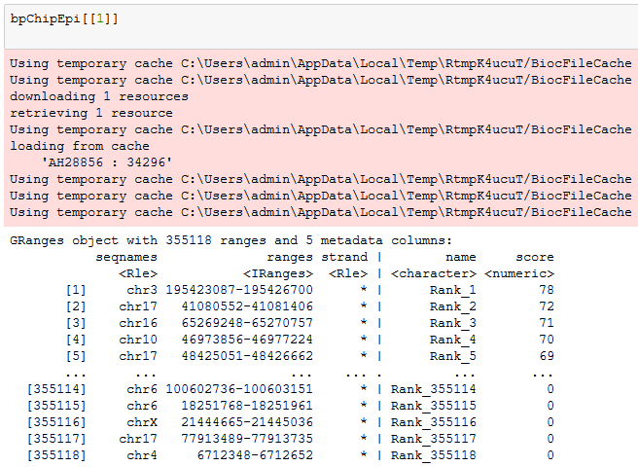
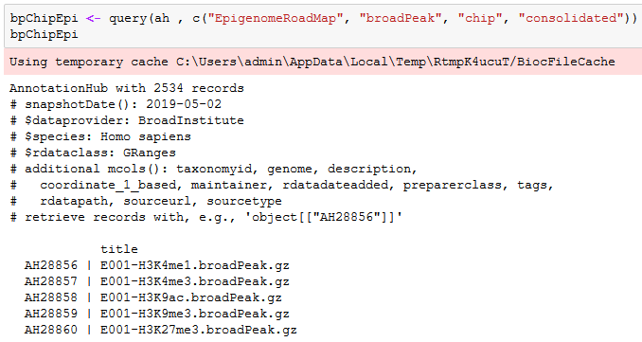
AnnotationHub
In AnnotationHub you first find the specific dataset you are looking for...
…And then you retrieve it.
Source: Package documentation

Slide 14
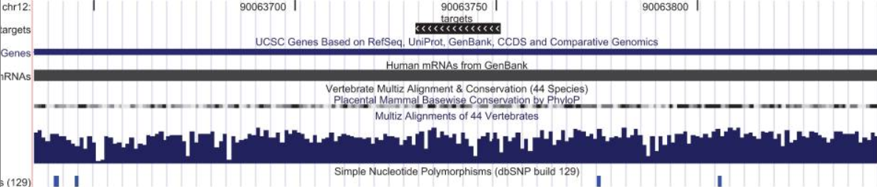
rtracklayer
rtracklayer is an interface between R and genome browsers (specifically, the UCSC genome browser).
The UCSC genome browser
Source: Package documentation and paper

Slide 15
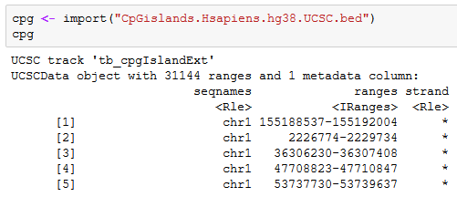
rtracklayer
Four main functions:
1) Import from file to R
2) Export from R to file
(files include bed, gff, and wig)
Source: Package documentation and paper

Slide 16
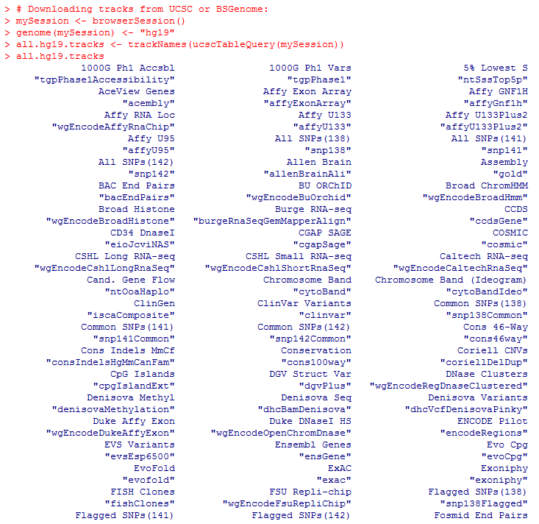

rtracklayer
Four main functions:
3) Retrieve from UCSC browser
4) Send files to visualize at UCSC browser
Tracks
Tables

Slide 17
Other annotation software
* GEOquery
* biomaRt

Slide 18
3. Working on Visualization

Slide 19


Gviz
* Similar to a genome browser in R (different types of data are represented by separate tracks). For example, three tracks for the genomic coordinates, the genes, and CpG islands.
* “When combining multiple objects, the individual tracks will always share the same genomic coordinate system”.
https://bioconductor.org/packages/release/bioc/vignettes/Gviz/inst/doc/Gviz.html

Slide 20
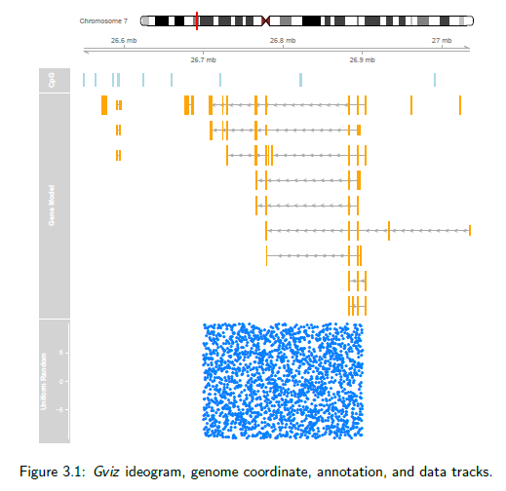
Gviz
And this is the result in R:

Slide 21
Now let’s go to the exercises...

